Slide 1
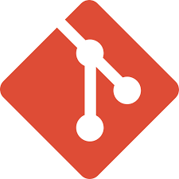
git repo icon

Slide 2
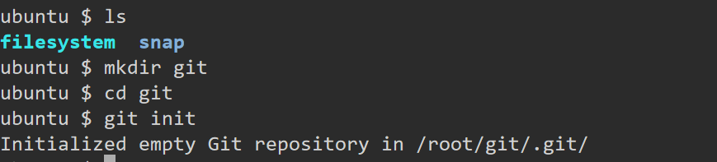
How to create local repository
What is GIT[local repository], how to create local repository
>>> create one directory[mkdir <directoryname> ; cd <directoryname> ] then run "git init" command

Slide 3
How to create remote repository in GIT
Create a Repository on GitHub:
Log in to your GitHub account.
Click on the "+" icon in the upper right corner and select "New repository".
Fill in the repository name, description (optional), and choose whether it should be public or private.
Click "Create repository".

Slide 4
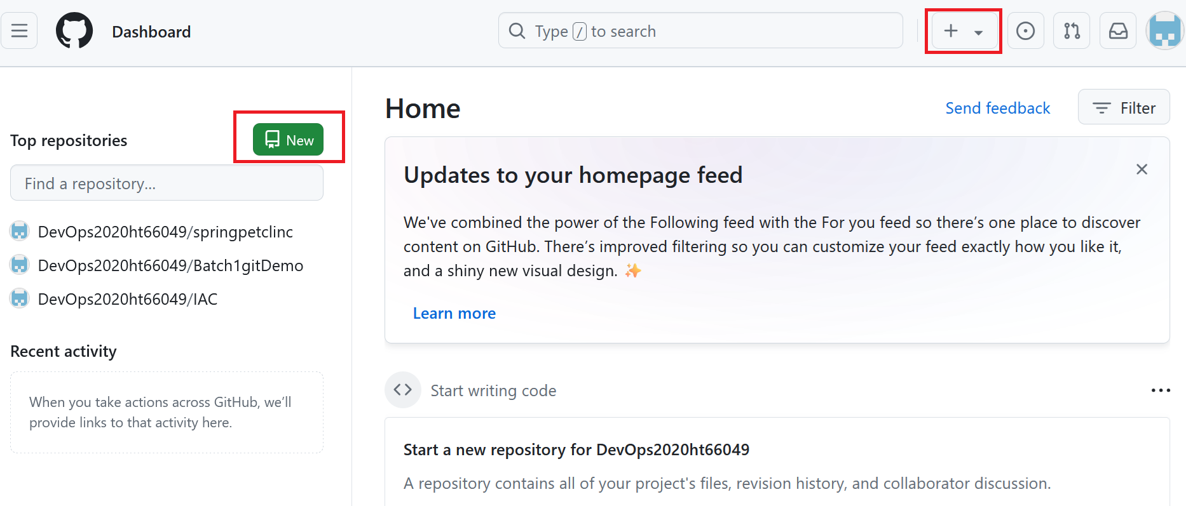

Slide 5
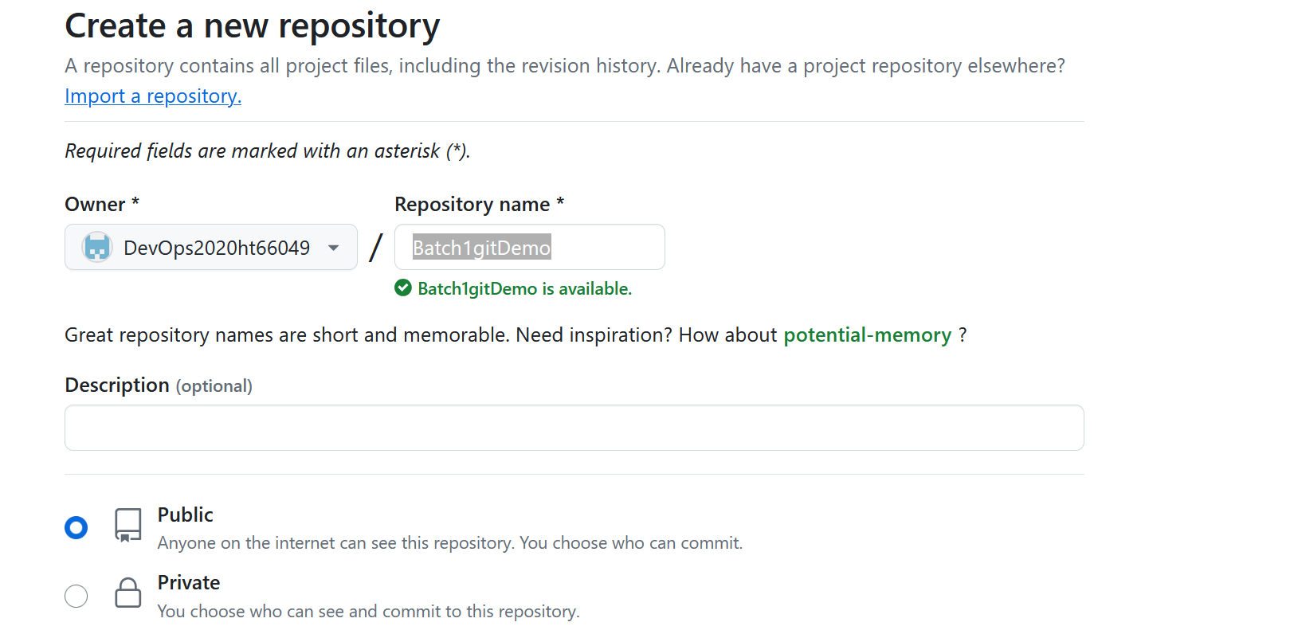

Slide 6
Local to remote communication
We need to generate token for it.
Token based authentication: https://docs.github.com/en/authentication/keeping-your-account-and-data-secure/managing-your-personal-access-tokens
Please follow above steps to generate token, please see next step and generate classic token only.

Slide 7
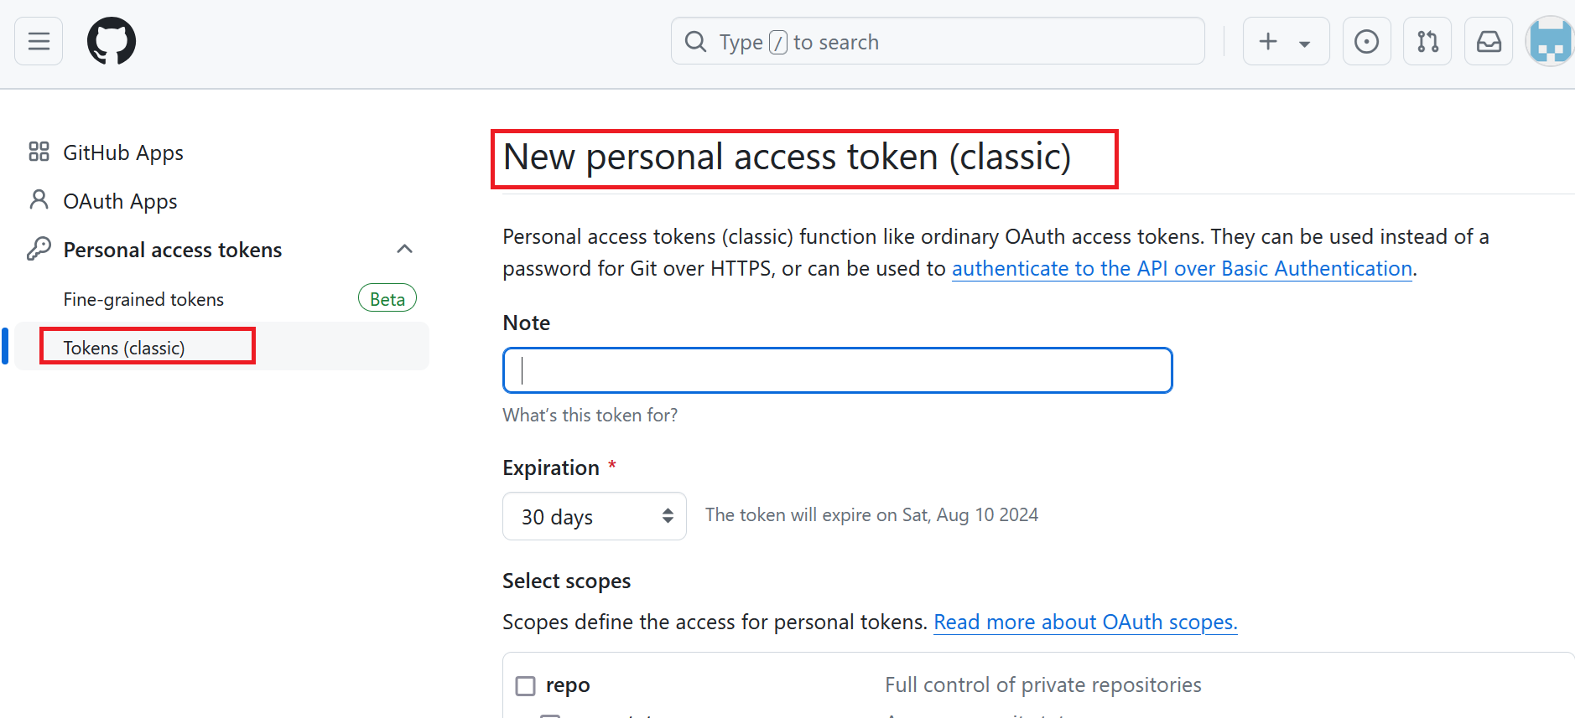

Slide 8

Sample token
ghp_ABCDEFGHIJKLMNOPQRSTUVWXYZ

Slide 9
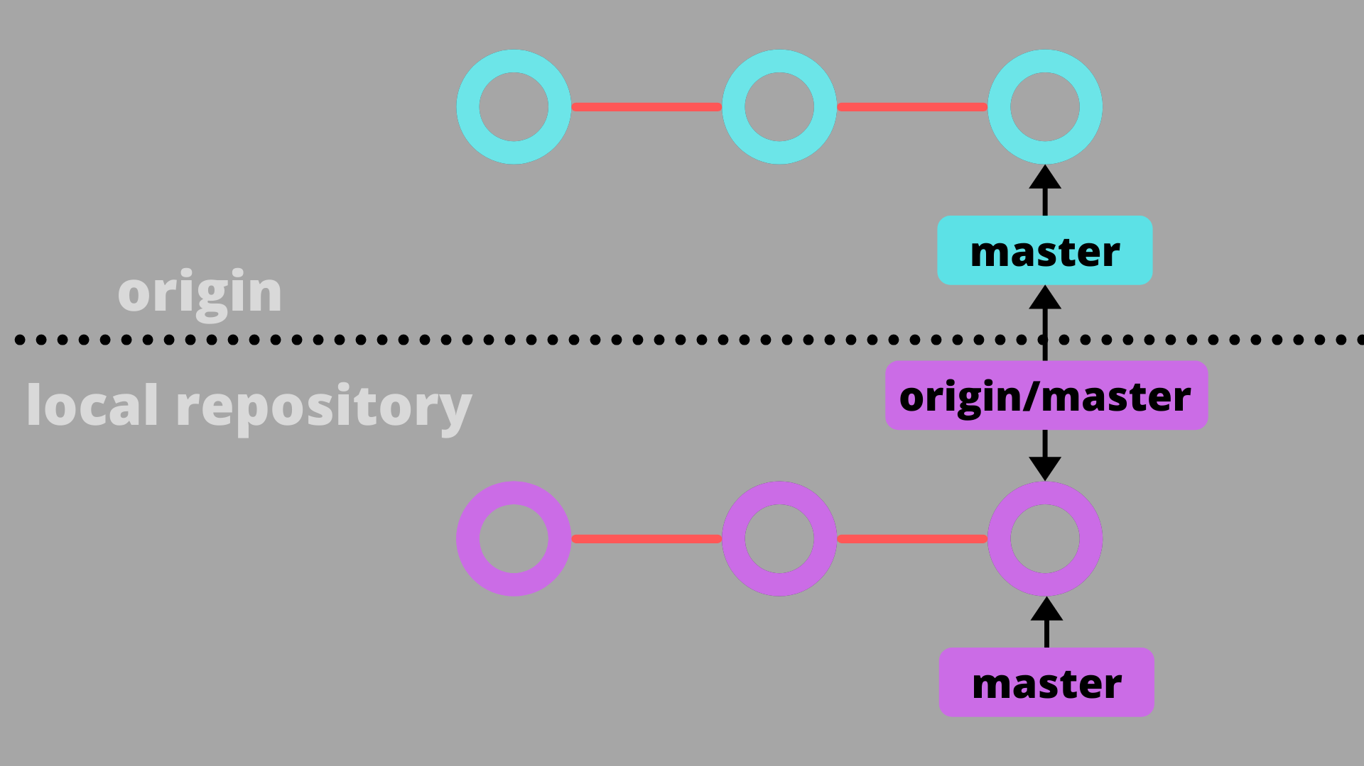
Command to establish connection
git remote set-url origin https://<GITHUB_ACCESS_TOKEN>@github.com/<GITHUB_USERNAME>/<REPOSITORY_NAME>.git

Slide 10
Command to push the change from local to remote
git add
git commit -m “message”
git push

Slide 11

What is VCS
It’s a mechanism to track the file change details

Slide 12
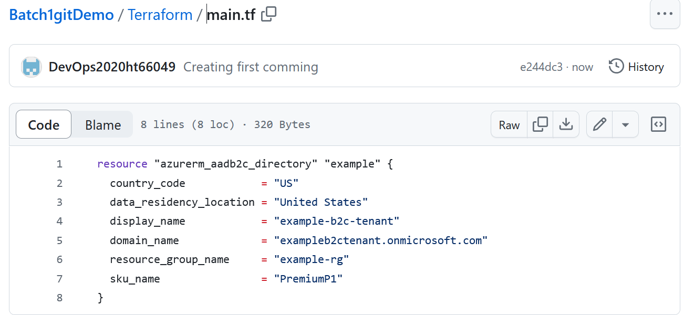

Slide 13
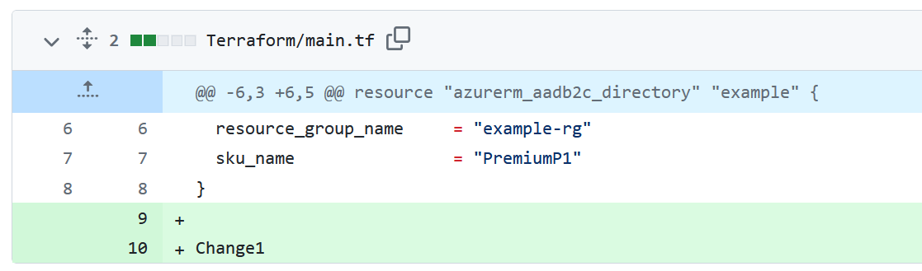

Slide 14
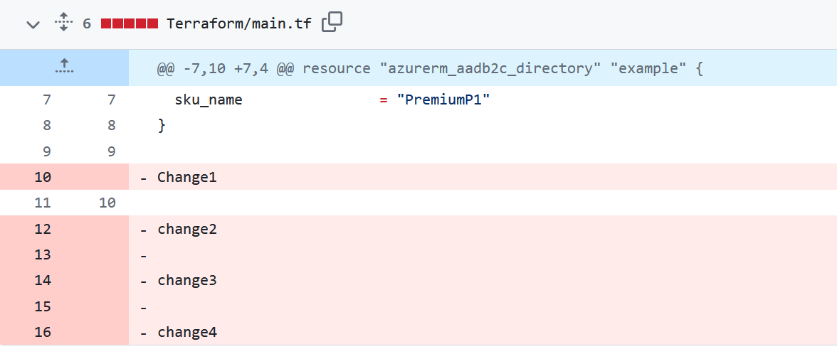

Slide 15
How to install/uninstall and version check
apt-get update
apt install git –y
apt-get update
apt remove git –y
git --version

Slide 16
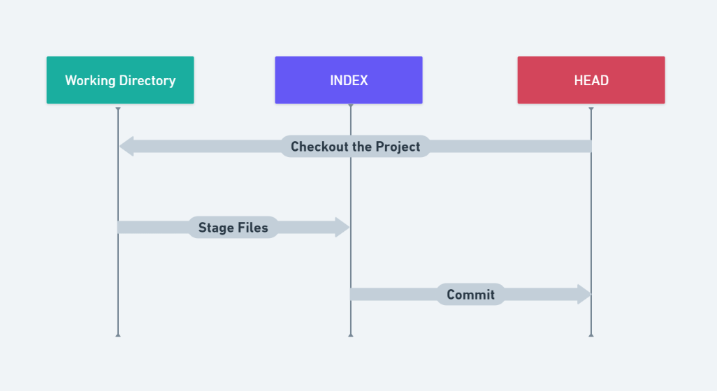
Working tree in GIT

Slide 17
Working directory
In Git, the working directory (or working tree) is the directory on your computer where you have checked out your project's files from the repository. It consists of the current state of the files you are working on and allows you to make changes, add new files, and remove files. Here's a breakdown of some key concepts related to the working directory in Git:

Slide 18
Stagging area
Staging Area (Index): Before committing changes to the repository, you first need to stage them. This area is a middle stage between the working directory and the repository. You use the git add command to add changes from the working directory to the staging area.
It perform two activity-
1) Encryption, 2) Comression

Slide 19
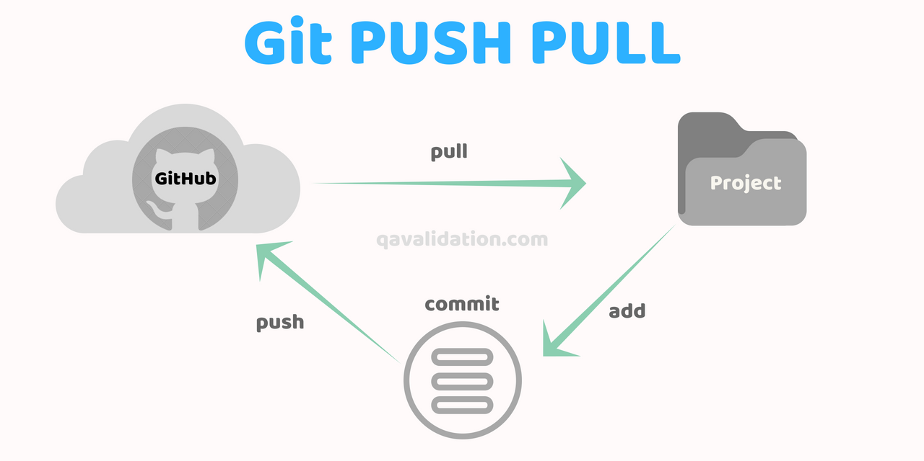
git pull and git push

Slide 20
git fetch
The git fetch command is used to download commits, files, and refs from a remote repository into your local repository. It retrieves data from the remote repository without modifying your working directory. This allows you to see what others have been working on without merging their changes into your current branch.

Slide 21
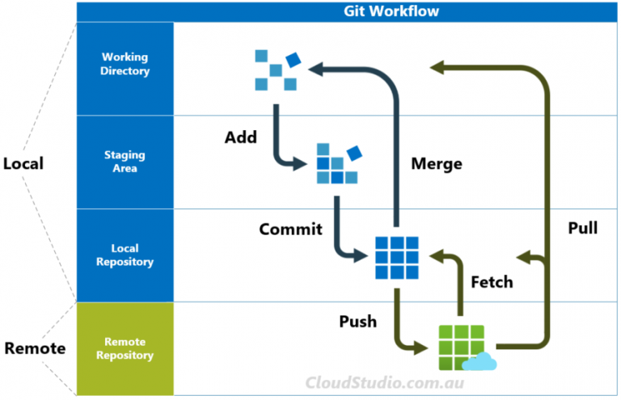

Slide 22
git fork
A fork in Git is a personal copy of someone else's repository. A fork allows you to freely experiment with changes without affecting the original project. Forks are often used in open source projects, where developers can fork a repository, make changes, and then submit those changes back to the original project through a pull request.

Slide 23
Branching
Branching in Git allows you to create separate lines of development within a repository. Each branch can have its own commits and changes, allowing you to work on multiple features or fixes simultaneously without interfering with the main codebase.

Slide 24
Branching command
Create a branch: git checkout branch name
Switch to a branch: git branch branch name
Create and switch to branch: git checkout –b branchname
Delete a branch: git branch -d <branch-name>
Deleting a branch forcefully: git branch -D <branch-name>
Listing branches: git branch

Slide 25
main branch in git
The main branch in Git (previously, the default branch was often named master) is typically the primary branch where the source code of your project is considered to be in a stable state. This branch is used for deploying production-ready code and is the branch that most collaborators will work from or base their branches off of.

Slide 26
Merging
Merging in Git is the process of combining changes from one branch into another. This is typically done when you want to incorporate the work done in a feature branch into the main branch or another branch. Merging can be straightforward if there are no conflicts, or it can require manual intervention if there are conflicting changes.

Slide 27
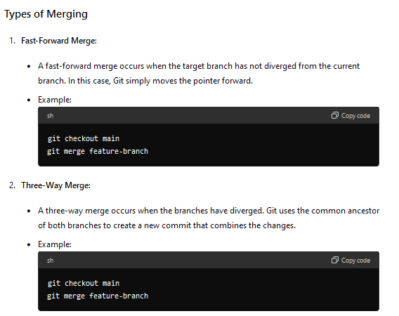

Slide 28
Azure Repo
Azure Repos is a set of version control tools provided by Microsoft Azure that you can use to manage your code. It supports both Git (distributed version control) and Team Foundation Version Control (TFVC). Most developers prefer Git due to its distributed nature and flexibility.

Slide 30
Topic yet to discuss
git reset
git head
Pull request
git advance security
git tag
git import

